Slide 1

Facebook Live Sellers in Thailand Dataset
By:- Siddhikesh Gavit

Slide 2
Overview of DATASET
Number of Instances: 7050 rows
Number of Attributes: 14 (after removing redundant columns,Total =16)
Attribute Information:
- status_id: Unique identifier for each status post.
- status_published: Date and time when the status post was published.
- status_type: Nature of the status post (e.g., video, photo, status, link).
- num_reactions: Number of reactions (e.g., likes, loves, wow, haha, sad, angry) received on the status post.
- num_comments: Number of comments received on the status post.
- num_shares: Number of shares received on the status post.
- Additional numerical and categorical attributes related to engagement metrics and status post features.

Slide 3
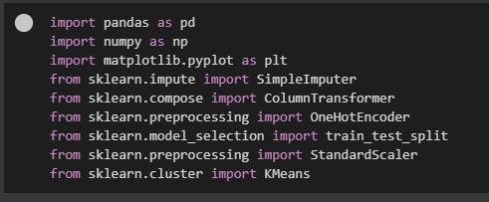
Libraries used…
Pandas
Numpy
Matplotlib
Sklearn with various different methods and modules

Slide 4
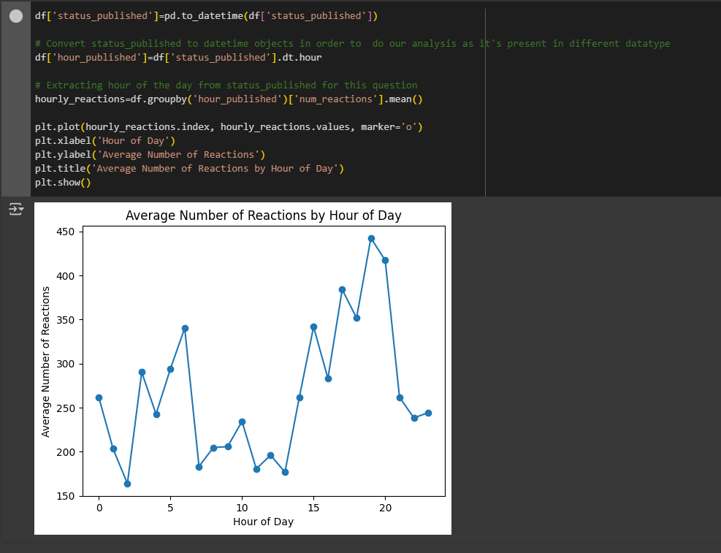
Q1. How does the time of upload (`status_published`) affects the `num_reaction`?
Approach:-
Convert status_published into hrs for analysis
Plot trends in num_reactions against status_published
Insights:-
Analyze whether posts published at certain times or on
specific days/weekends get more reactions
Identify peak times for management

Slide 5
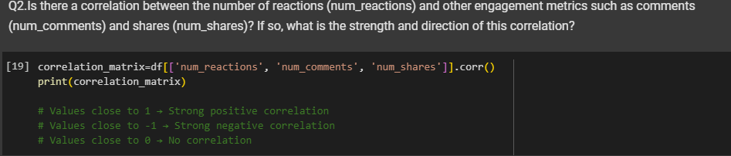
Q2. Is there a correlation between the number of reactions (num_reactions) and other engagement metrics such as comments (num_comments) and shares (num_shares)? If so, what is the strength and direction of this correlation?
Approach:-
Caluculate the correlation matrix between num_reaction,num_comments and num_shares
Refer to comments in SS
Insights:-
→ Explain the strength and direction of correlations

Slide 6
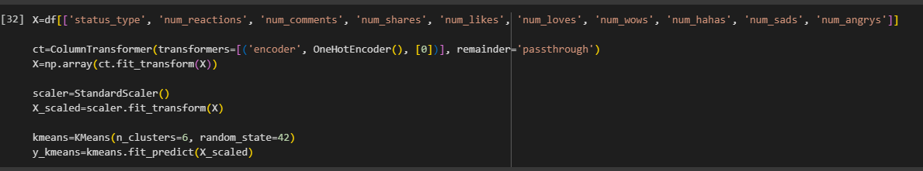
Q3. Use the columns status_type, num_reactions, num_comments, num_shares, num_likes, num_loves, num_wows, num_hahas, num_sads, and num_angrys to train a K-Means clustering model on the Facebook Live Sellers dataset.
Approach:-
Features used for clustering: status_type,num_reactions,num_comments,num_shares and emotional reactions.
Train a K-Means model on these features.
Insights:-
→ Explain the clustering process and how posts are grouped based on engagement metric.

Slide 7
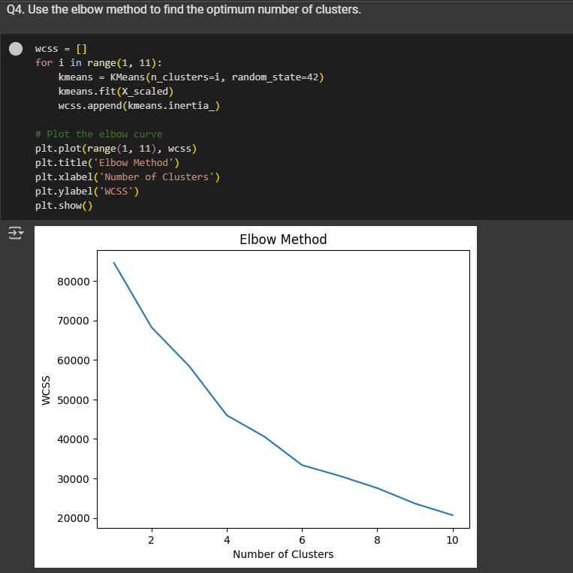
Q4. Use the elbow method to find the optimum number of clusters.
Approach:-
Identify “elbow point “ using Elbow Method
Insights:-
→ Show the plot and learned to identify how to know optimal no. of clusters required .

Slide 8
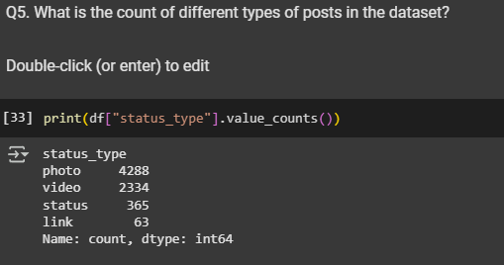
Q5. What is the count of different types of posts in the dataset?
Approach:-
Analyze and show distinct status_type column
Insights:-
→ Display the distribution of post types in tabular form

Slide 9
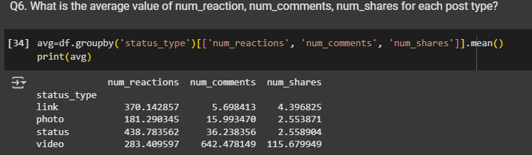
Q6. What is the average value of num_reaction, num_comments, num_shares for each post type?
Approach:-
Calculate avg of num_reactions,num_comments, num_shares for each status_type
Insights:-
→ Identify which post types generate more reactions,comments and shares

Slide 10
THANK YOU…
@Finlatics…

